Slide 1
The road to DNSRocks
Why would you write your own authoritative DNS server?
Balint Csergo
Production Engineer

Slide 2
Agenda
History
TinyDNS
DNSRocks with CDB backend
DNSRocks with RocksDB
DNSRocks OpenSource

Slide 3
01 History

Slide 4
What do we need from a DNS server?
01 History
Resolver IP based “views”
EDNS Client Subnet “views”
Simple to generate views
Simple to configure
Simple to deploy DB updates
Query Logs
Health metrics
Latency requirements

Slide 5
DNS pipeline
Config Repo
HOST DB
Network DB
DNS MUTATOR
Zookeeper
DNS Presenter
DNS Publisher
Zookeeper
Trackerless Torrent
CORP
DNS HOST
Subscriber
Automations
Unbound
dnsrocks
Clients
dnsrocks
dnsrocks
dnsrocks

Slide 6
01 History
2012
2018
2020
2022
TinyDNS
DNSRocks with CDB backend
DNSRocks with RocksDB
Open Sourcing DnsRocks
We have been using TinyDNS (with patches)
IPv6 support
EDNS Client Subnet location matching
Multiple Map support
We start running our own implementation of an authoritative DNS server. We are still using a TinyDNS compatible format by default
We migrate from CDB to a RocksDB backend to support data growth
Split off proprietary bits and provide useful Open source alternatives
Switch to upstream dependencies where it made sense

Slide 7
02 TinyDNS

Slide 8
What was great about TinyDNS?
02 TinyDNS
Simple
Efficient
Very fast
Line-based zone format
Distributing data.cdb is simple

Slide 9
What was not so great about TinyDNS?
02 TinyDNS
Antiquated hard to read C code
Not easy to extend
Simplicity comes with trade-offs
Lack of tests and modern programming paradigms
Lot of global/static variables
Hard for engineers to ramp up
Single threaded

Slide 10
Open Source Alternatives
02 TinyDNS
 | Resolver View Supported | ECS View Supported
BIND | ✅ | ❌
Knot | ❌ (Until 2.7.0) | ❌ (Until 2.7.0)
NSD | ❌ | ❌
PowerDNS | ✅(geoip backed) | ✅(geoip backed)

Slide 11
03 DNSRocks with CDB Backend

Slide 12
Roll your own
03 DNSRocks with CDB Backend
Go is a modern language
miekg/dns is an amazing library, we’ve built on top of that
We reuse a lot of plumbing from CoreDNS
Go tooling makes building/running/testing easy
Good unit test coverage was a must
Faster iteration speed
Works with CDB, compatible with internal tooling
Feature parity with TinyDNS, so rollout and A/B testing was “simple”
A/B testing enabled us to profile our code, and optimize hotspots

Slide 13
04 DNSRocks with RocksDB

Slide 14
What’s good about CDB
04 DNSRocks with RocksDB
speed: Data access is very very fast
It’s a constant database, it can be mmapped
We know how to work with it already
It’s a very simple data structure, basically a hashmap

Slide 15
What’s bad about CDB
04 DNSRocks with RocksDB
It’s a constant database, we need to redeploy the whole view on every change, which causes constant recompilation, and increased propagation time
This constant DB rewrite leads to SSD wear, we needed to store the DB in Ramdisk
It’s a 32 bit hashmap. 4 GB is the maximum size of a cdb database

Slide 16
RocksDB
04 DNSRocks with RocksDB
speed: RocksDB being mutable means we don’t recompile anything. Incremental updates are possible and applying changes takes milliseconds.
SSD wear: RocksDB is flash-ready, which meant we’ve been be able to move back to SSDs and free up some precious RAM
32-bit limitations of CDB no longer apply, shards can get as big as we need. 4 GB isn’t enough for everybody :)

Slide 17
RocksDB
04 DNSRocks with RocksDB
The steps we took:
Writing CGO wrapper around RocksDB so it could be used in Go
Adding alternative backend support in DNSRocks
Creating native go parser and compiler from TinyDNS configuration format to CDB and RocksDB
Rethink how we do maps to better utilize RocksDB’s findClosest

Slide 18
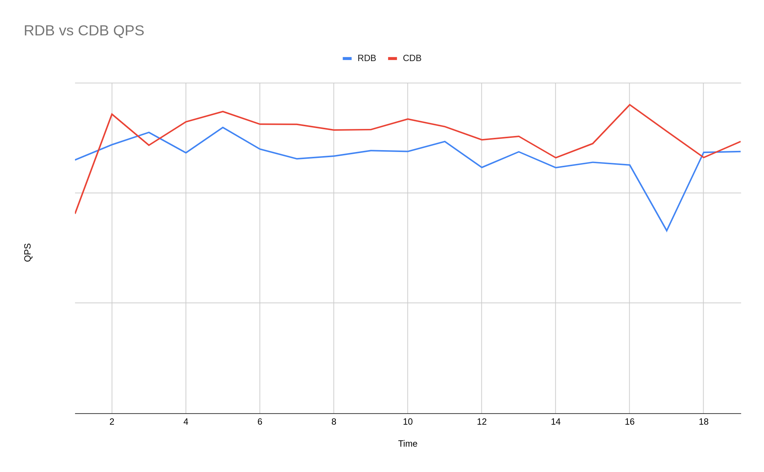
04 DNSRocks with RocksDB
DNS server performance comparison

Slide 19
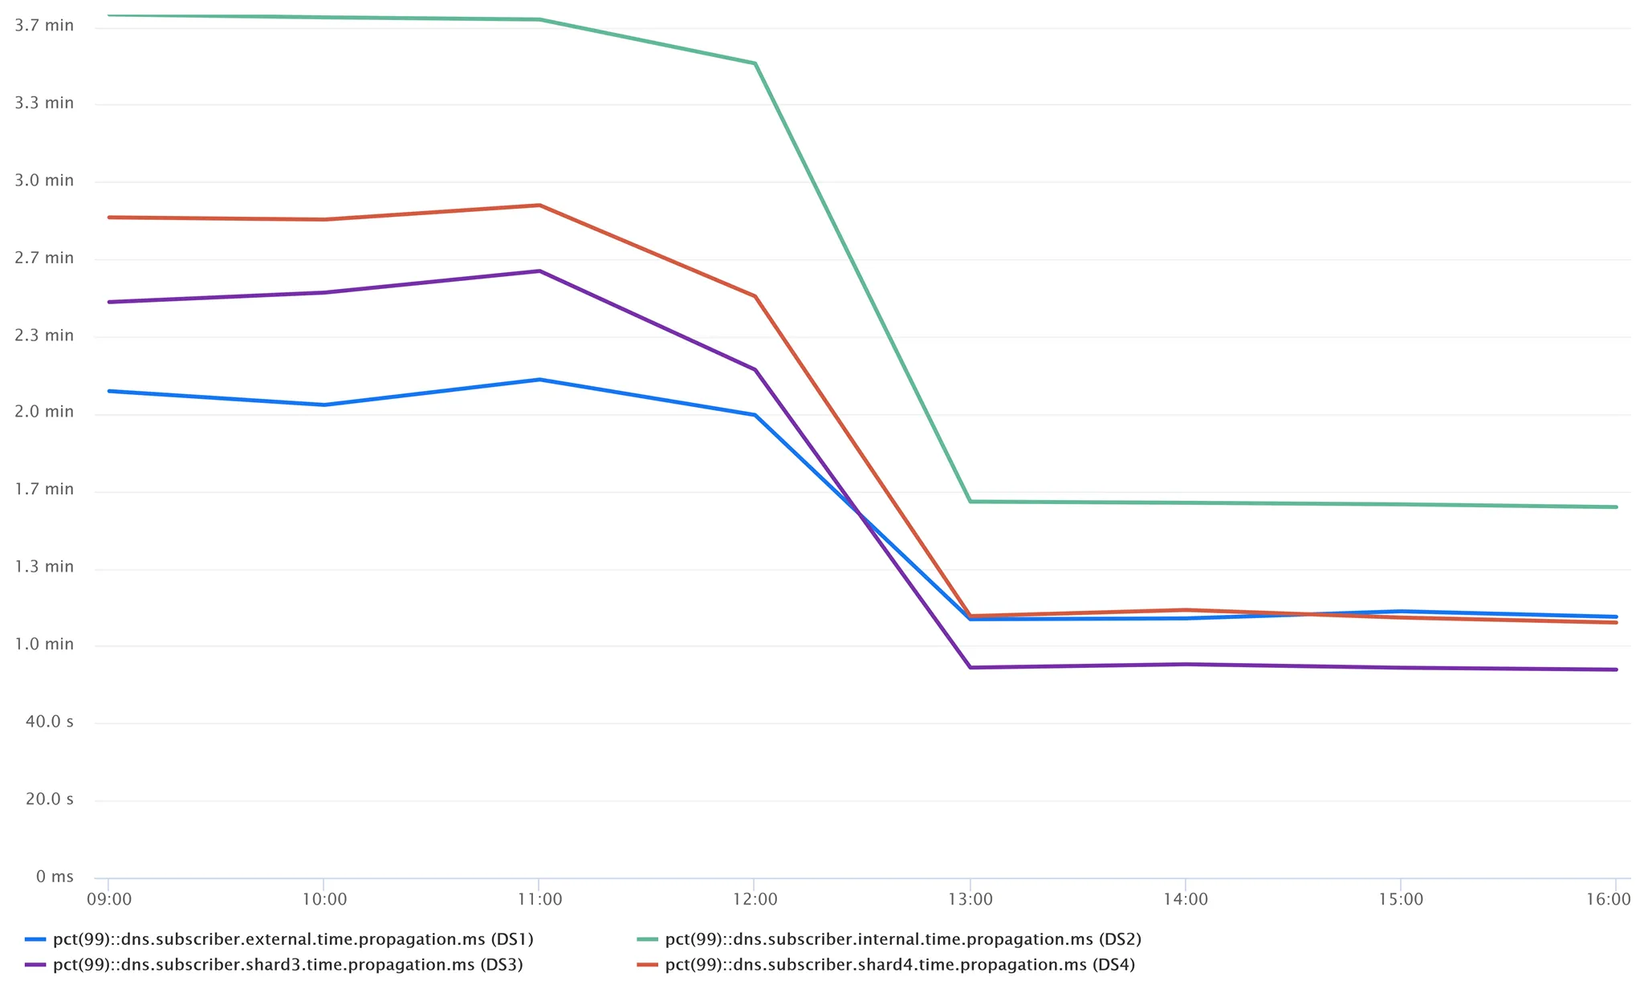
04 DNSRocks with RocksDB
DNS propagation time wins on Rocksdb

Slide 20
05 DNSRocks Open Source

Slide 21
DNSRocks Open Source
04 DNSRocks Open Source
The steps we took:
Split off proprietary pieces of code
Provide reasonable OSS alternatives (Prometheus metrics + dnstap logger)
Switch to upstream dependencies wherever possible
CI pipeline on github
Documentation

Slide 22
Thanks
Manu Bretelle (@chantra)
Yaroslav Kolomiiets (@yarikk)
Oleg Obleukhov (@leoleovich)
Andrei Lukovenko (@alukovenko)
Alex Bulimov (@abulimov)
Pablo Mazzini (@pmazzini)
Patrick Cullen (@t3lurid3)
Vadim Fedorenko (@vvfedorenko)
Trinity Mirell (@trynity)
Maxime Montinet
Jinyuan Feng
Ivan Laktyunkin
Yang Yu

Slide 23
04 Questions

